Slide 1
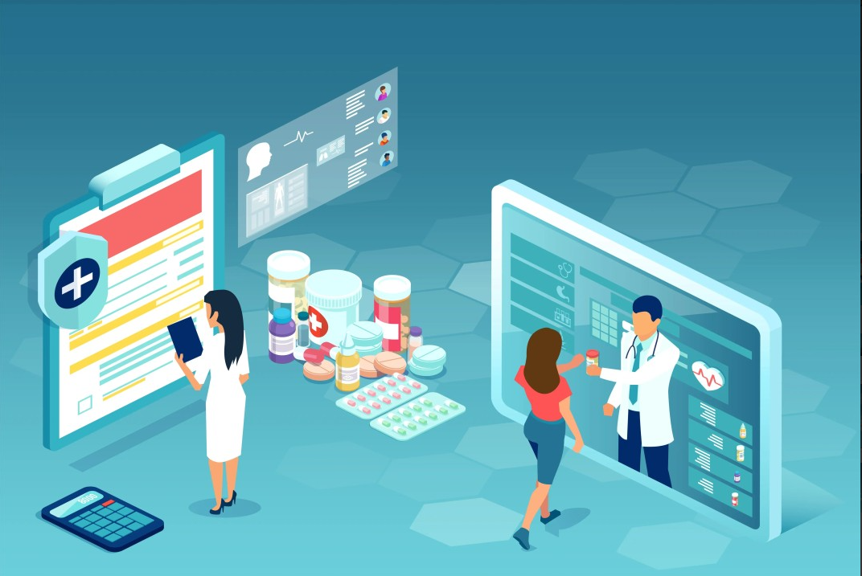
PHARMACY MANAGEMENT SYSTEM

Slide 2
ABSTRACTION
System Overview:
The Pharmacy Management System (PMS) is a software solution designed to streamline and automate various operations within a pharmacy setting.
Functional Modules:
Customer Management: This module involves managing customer information, prescription records, purchase history, and notifications.
Sales Tracking: Tracks sales transactions, generates invoices, and provides real-time sales reports.
Medicine Inventory Control: Manages stock levels, tracks expiration dates, alerts for restocking, and optimizes inventory to avoid shortages or overstocking.
Key Features and Functionalities:
User Authentication: Secure login access for different roles like pharmacists, administrators, and staff members.
Dashboard and Reporting: Provides a comprehensive overview with graphical representations and detailed reports for better decision-making.
Automated Alerts and Notifications: Notifies staff about low stock, expiring medications, pending orders, etc., reducing manual checks and errors.
Integration Capabilities: Integrates with external systems for e-prescriptions, insurance, or healthcare providers' systems for seamless information exchange.
Transaction Processing: Facilitates quick and accurate sales processing, prescription verification, and payment handling.
Data Backup and Security: Ensures data integrity, regular backups, and implements security protocols to safeguard sensitive information.

Slide 3
Benefits:
Efficiency Improvement: Reduces manual effort, minimizes errors, and optimizes workflows, enhancing operational efficienc
Enhanced Customer Service: Enables faster service, prescription fulfillment, and personalized customer interaction.
Inventory Optimization: Prevents overstocking or shortages, reducing wastage and ensuring availability of essential medicines.
Accuracy and Compliance: Helps in maintaining accurate records, adhering to regulations, and improving compliance with healthcare standards.
Cost Reduction: Reduces labor costs, minimizes inventory losses, and streamlines processes, leading to overall cost savings.
Technology Stack:
HTML,CSS,JAVASCRIPT FOR FRONT END AND PHP FOR BACKEND
Development and Implementation Plan:
Requirement gathering and analysis
System design and architecture planning
Development and testing phases
Training for pharmacy staff
Rollout and implementation with continuous support and updates.
This abstraction provides a high-level overview of the proposed Pharmacy Management System, focusing on its functionalities, features, benefits, technological aspects, and the general development approach.

Slide 4
INTRODUCTION
1.1 Problem Statement:
The management of a pharmacy involves complex operations, including pharmacist management, customer management, sales tracking, medicine inventory control, andmonitoring of supplier details. Current manual processes are error-prone,time-consuming, and inefficient, leading to challenges in providing quality healthcareservices. To address these issues, we propose the development of a comprehensivePharmacy Management System (PMS).
1.2 Purpose:
The purpose of this document is to specify the software requirements for the Pharmacy Management System (PMS). The system aims to streamline pharmacy operations, enhance customer service, and improve inventory and sales management.

Slide 5
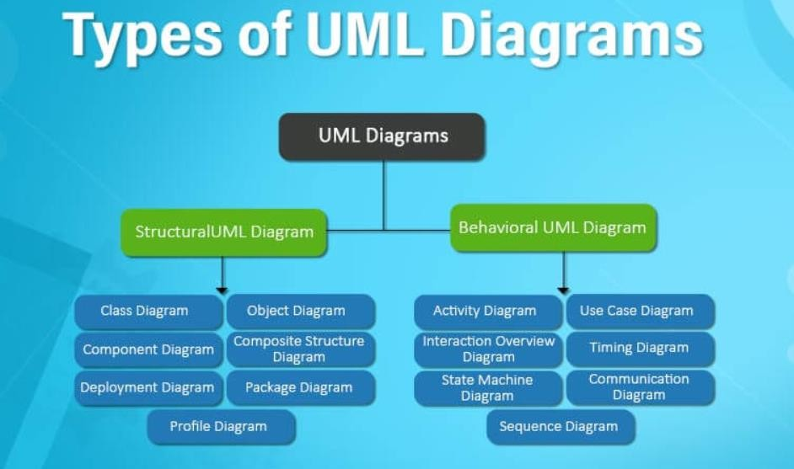
UML DIAGRAMS
UML, which stands for UNIFIED MODELLING LANGUAGUE is a way to visually represent the architecture, design, and implementation of complex software systems. When you’re writing code, there are thousands of lines in an application, and it’s difficult to keep track of the relationships and hierarchies within a software system. UML diagrams divide that software system into components and subcomponents

Slide 6
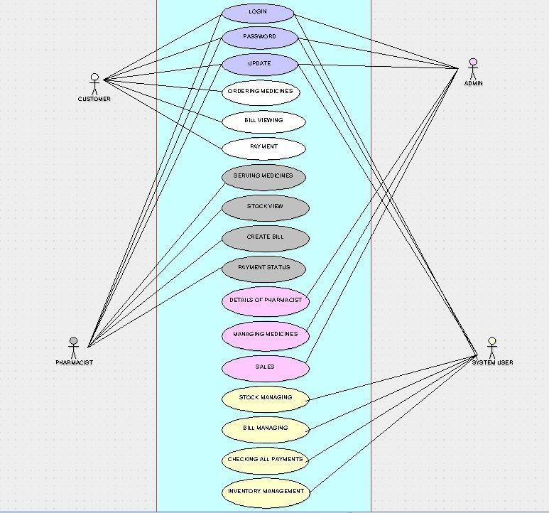
USE CASE DIAGRAM:
This Use Case Diagram is a graphic depiction of the interactions among the elements of Pharmacy Management System. It represents the methodology used in system analysis to identity Clancy, and organize system requirements of Pharmacy Management System The main actors of Pharmacy Management System in this Use Case Diagram are Super Admin System User, Shopkeeper, Customers, who perform the different type of use cases such as Manage Pharmacy Manage Medicines, Manage Stocks, Manage Company Manage Inventory Manage Sells, Manage Users and File Pharmacy Management System Operations Major elements of the UML use case diagram of Pharmacy Management System are shown on the picture below

Slide 7
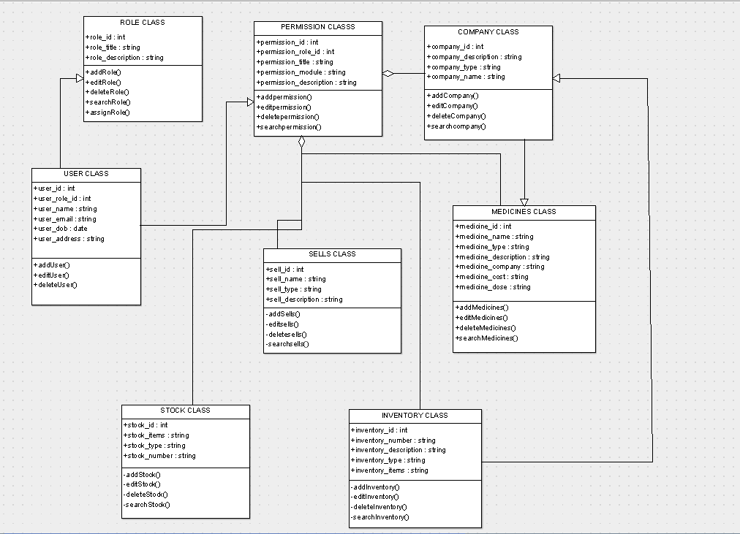
CLASS DIAGRAM:
Pharmacy Management System Class Diagram describes the structure of a Pharmacy Management System classes, their attributes, operations (or methods), and the relationships among objects. The main classes of the Pharmacy Management System are Pharmacy, Medicines, Stocks, Company, Inventory, Sells

Slide 8
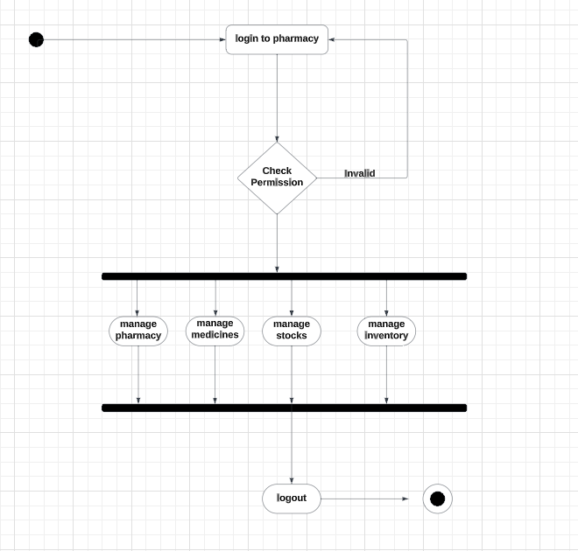
Activity Diagram:
Admin User can search Inventory, view description of a selected Inventory, add Inventory, update Inventory and delete Inventory.
Its shows the activity flow of editing, adding and updating of Company
User will be able to search and generate report of Sells, Medicines, and Pharmacy
All objects such as (Inventory, Pharmacy) are interlinked
Its shows the full description and flow of Inventory, Medicines, Pharmacy, Sells.
Admin login:

Slide 9
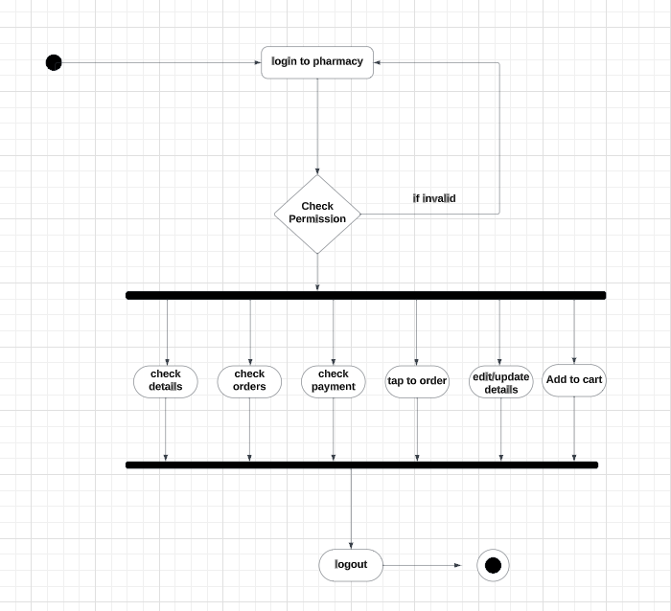
User login
:

Slide 10
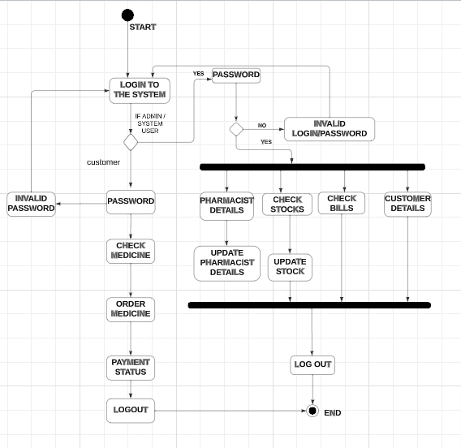
State diagram:
It is used to represent the condition of the entire system or a part of the system at finite instances of time. State diagrams are also referred to as State
Machines and State-chart Diagrams.
Login to the page, if admin click to the admin as the user page, if customers click to the customer page
Enter the correct password and continue the next procedure

Slide 11
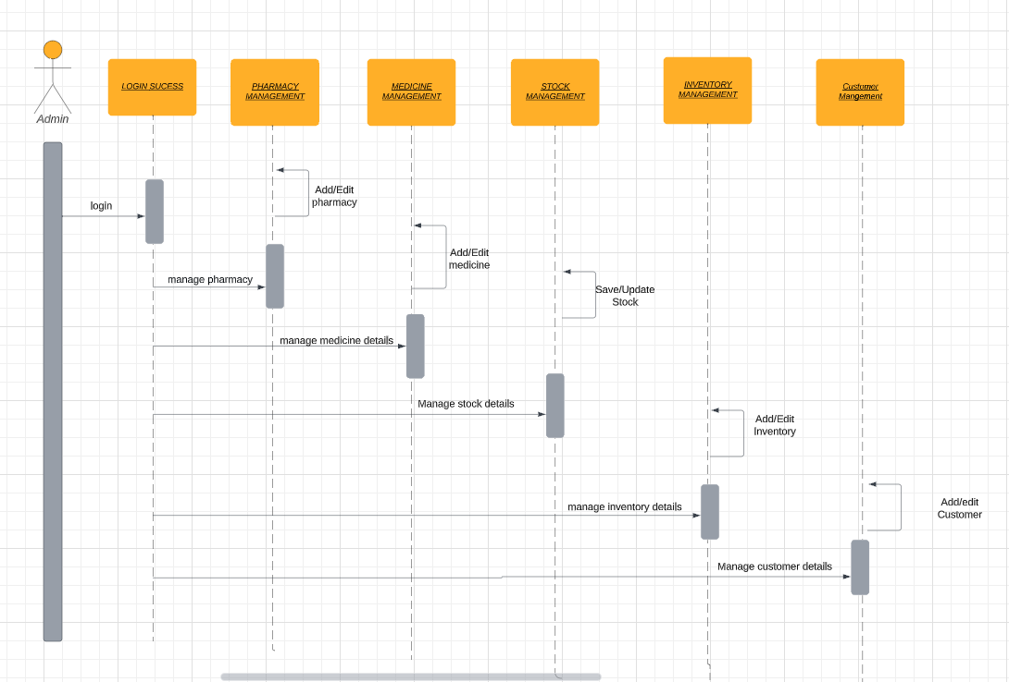
SEQUENCE DAIGRAM:
This is the UML sequence diagram of Pharmacy Management System which shows the interaction between the objects of Inventory, Sells, Medicines, Pharmacy. The instance of class objects involved in this UML Sequence Diagram of Pharmacy Management System are as follows:
Inventory Object
Sells Object
Medicines Object
Pharmacy Object

Slide 12
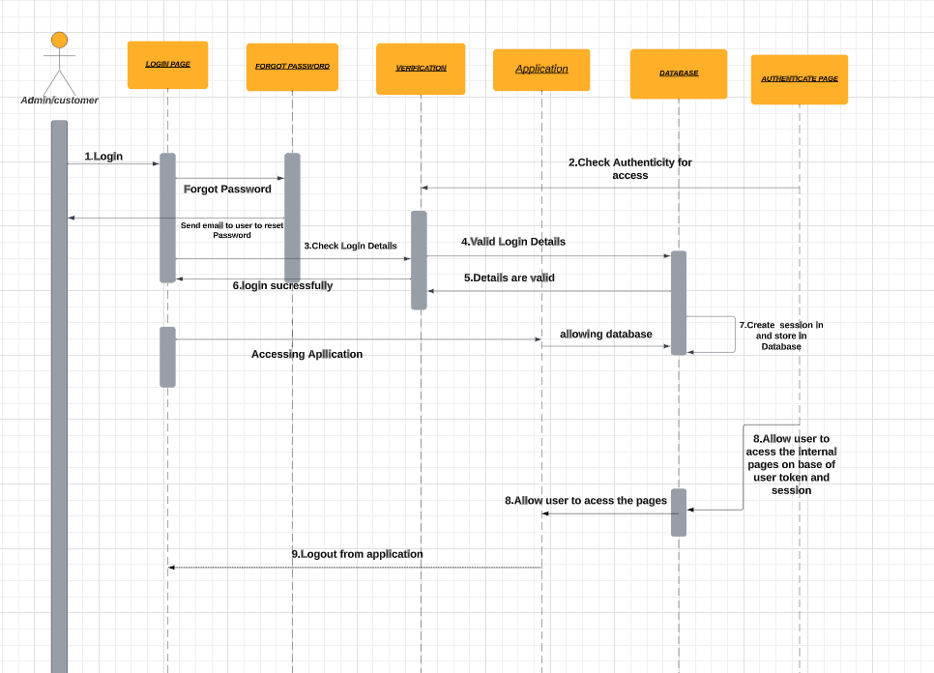
Login Sequence Diagram Of Pharmacy Management System:
This is the Login Sequence Diagram of Pharmacy Management System, where admin will be able to login in their account using their credentials. After login user can manage all the operations on Medicines, Inventory, Sells, Pharmacy, Company. All the pages such as Sells, Pharmacy are secure and user can access these page after login. The diagram below helps demonstrate how the login page works in a Pharmacy Management System. The various objects in the Pharmacy, Medicines, Inventory, Sells, and Company page-interact over the course of the sequence, and user will not be able to access this page without verifying their identity.

Slide 13
COLLABRATION:
A collaboration diagram is a type of visual representation that shows how different components of a system interact with each other. It emphasizes the structural organization of the objects that send and receive messages. In a collaboration diagram, the objects involved in a particular scenario are depicted along with the messages exchanged between them.
The components are:
Admin/customer
Login page
Verification
Database
Forgot password
Application

Slide 14
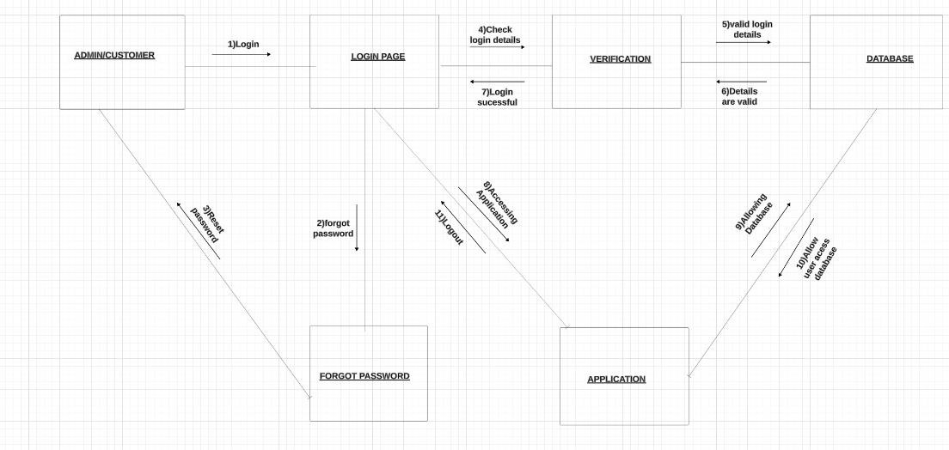
Diagram for the login page:

Slide 15
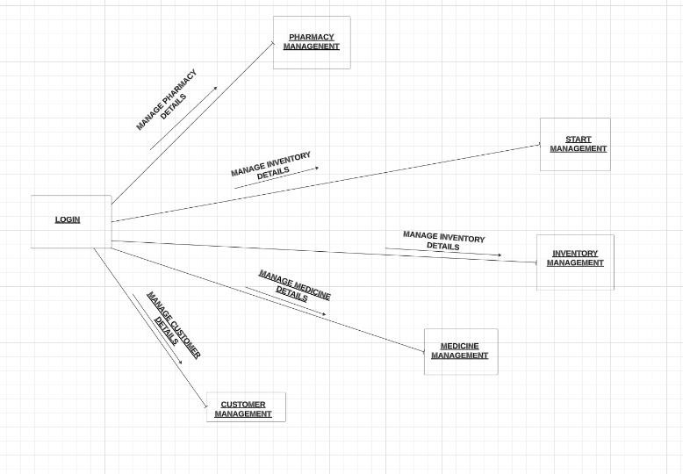

Slide 16
COMPONENT DAIGRAM:
This is a Component diagram of Pharmacy Management System which shows components, provided and required interfaces, ports, and relation. ships between the Company, Pharmacy, Sells, Inventory and Medicines. This type of diagrams is used in Component-Based Development (CBD) to de- scribe systems with Service-Oriented Architecture (SOA). Pharmacy Management System UML component diagram, describes the organization and wiring of the physical components in a system.
Components of UML Component Diagram of Pharmacy Management System:
Pharmacy Component
Sells Component
Inventory Component
Medicines Component
Features of Pharmacy Management System Component Diagram:
You can show the models the components of Pharmacy Management System.
Model the database schema of Pharmacy Management System
Model the executables of an application of Pharmacy Management System Model the system's source code of Pharmacy Management System

Slide 17
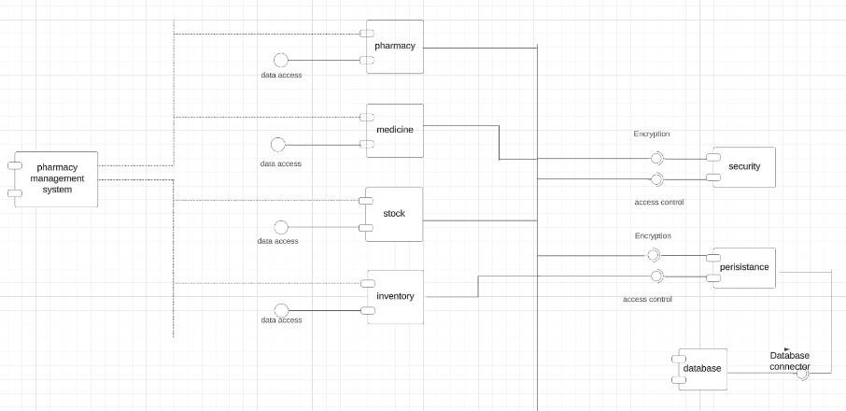

Slide 18
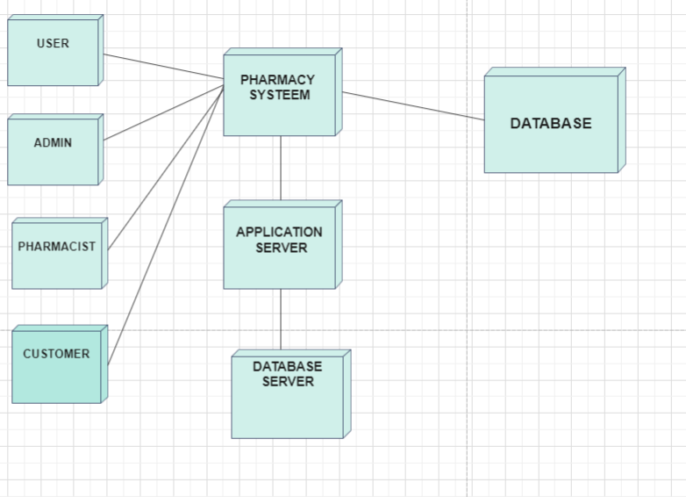
DEPLOYMENT DAIGRAM:
Deployment diagrams are used for describing the hardware components, where software components are deployed..
In the below diagram, the donors require only the pharmacy system. For this, there is a use for application server and database server.
Application server has the application part and the database server
consists of all the databases related to the project.
To store the data, we require a hardware part like data base, which has to be connected.

Slide 19
WEBSITE
Front page:
Welcome Banner:
A visually appealing banner welcoming users to the pharmacy website. Possibly
featuring promotions, discounts, or current offers.
Product Categories:
Clearly defined sections for different product categories (e.g., Prescription ,Medications, Over- The-Counter Drugs, Health Supplements).
Featured Products:
Showcasing popular or newly added products to catch the user's attention.

Slide 20
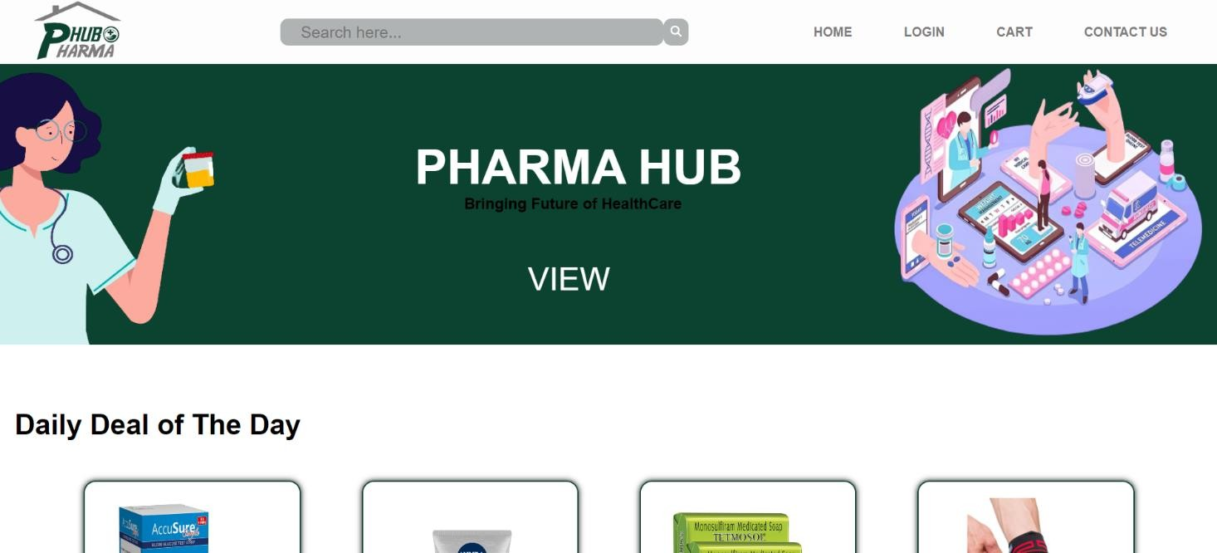
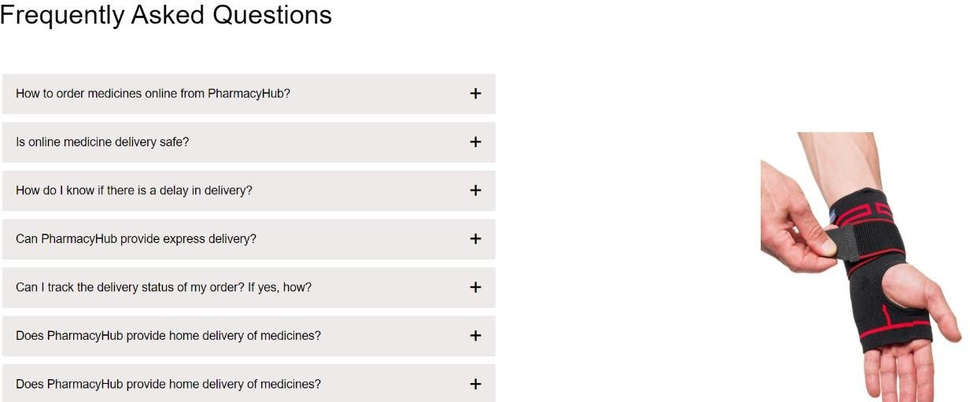

Slide 21
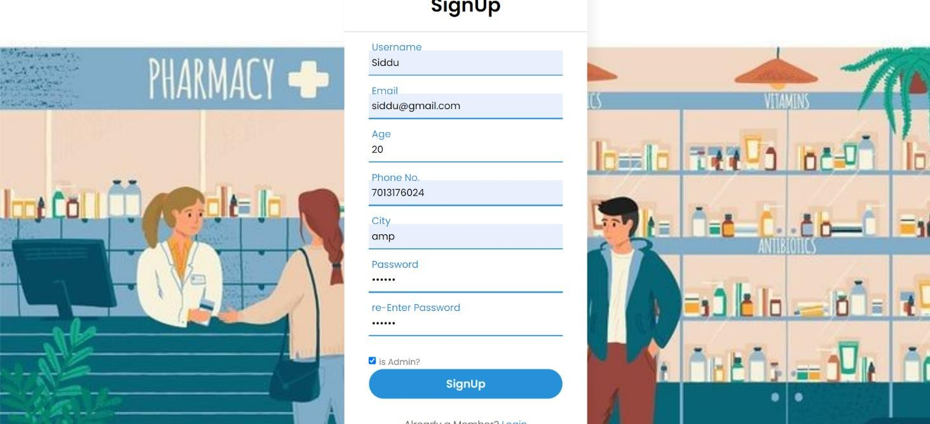
Sign Up Page:

Slide 22
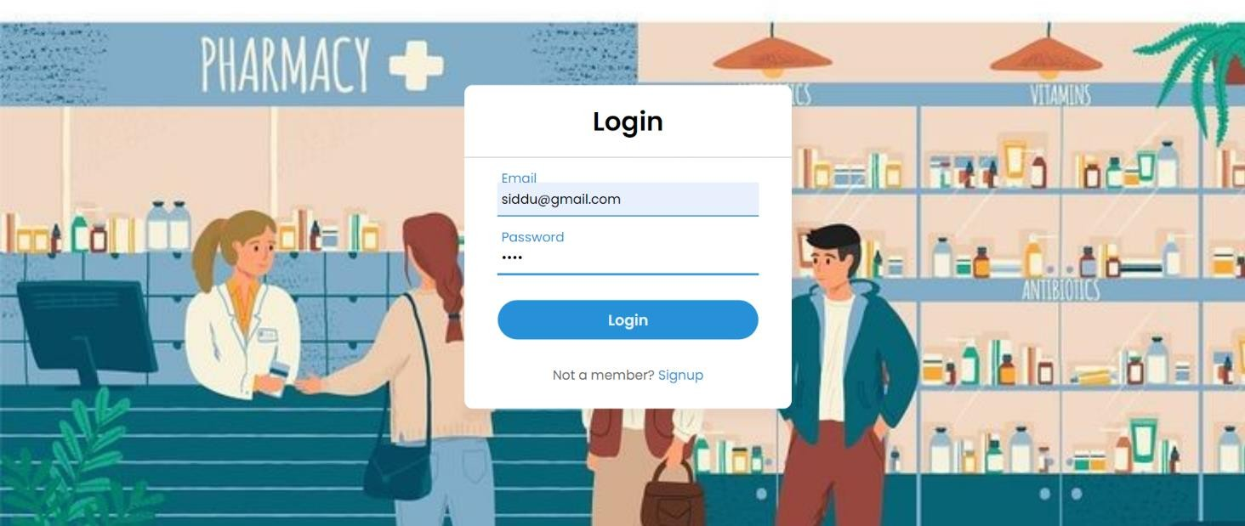
Login Page:
Username/Email and Password Fields:
Standard fields for users to enter their login credentials.
Create Account Link:
For new users, a link to the registration page to create a new account.
Security Information:
A brief note on the security measures implemented to protect user data.
Login Button:
Initiates the login process and redirects users to their personalized accounts.

Slide 23
Cart Page:
List of Selected Items:
Clearly displays the items users have added to their cart.
Quantity and Remove Options:
Allows users to adjust the quantity of each item or remove them from the cart.
Total Price Calculation:
Displays the total cost of the items in the cart.
Proceed to Checkout Button:
Takes users to the checkout process to complete their purchase.
Continue Shopping Button:
Allows users to go back to the product pages and add more items to their cart.

Slide 24
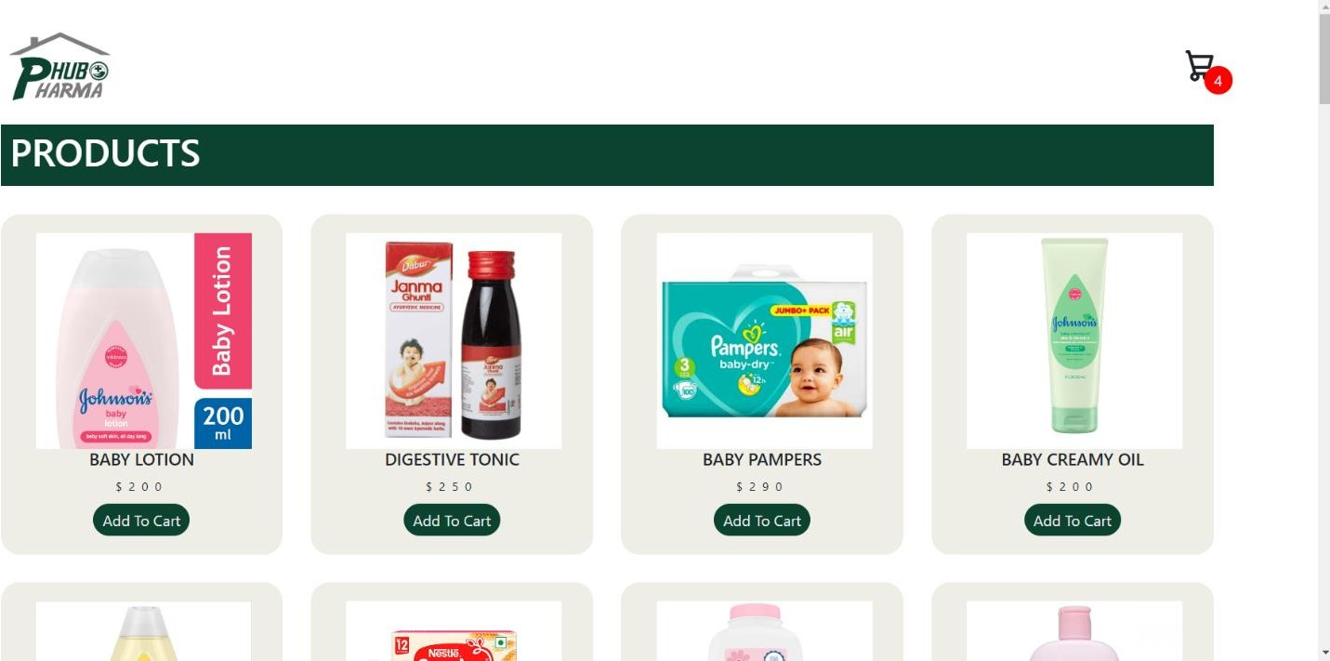
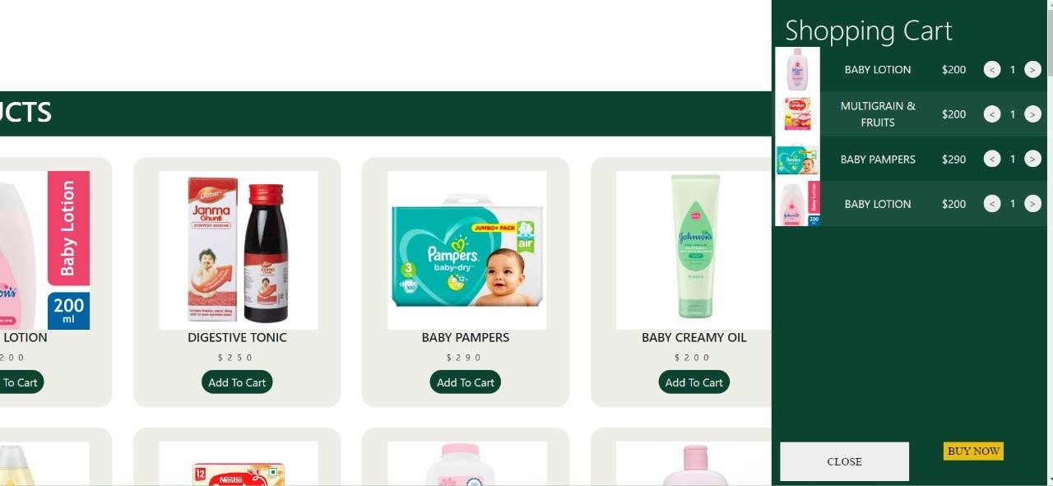

Slide 25
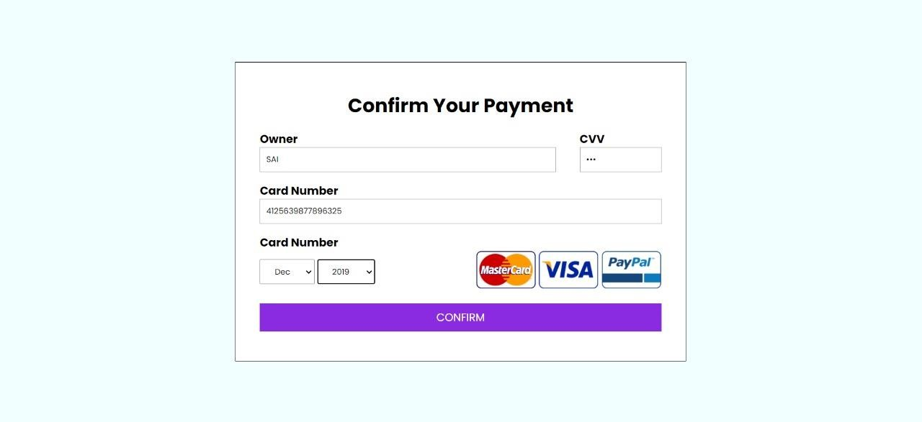
Payment Page:
Order Summary:
Display a clear summary of the items being purchased, including names, quantities, and total cost.
Billing Information:
Fields for users to enter billing details, including name, address, and contact information.
Payment Methods:
Multiple options for payment methods (credit card, debit card, digital wallets, etc.) with corresponding icons.
Card Information:
Fields for credit/debit card details, including card number, expiration date, and CVV

Slide 26

Payment Successful Page:
Order Confirmation:
Clearly state that the payment was successful and provide an order confirmation number.
Summary of Purchase:
Repeat the order details, including items purchased, quantities, and total cost.

Slide 27

Admin Login Page:
Username and Password Fields:
Standard fields for entering the admin's username and password.
Login Button:
A prominent button to initiate the login process.
Redirect to Dashboard:
After successful login, redirect the admin to the admin dashboard.

Slide 28
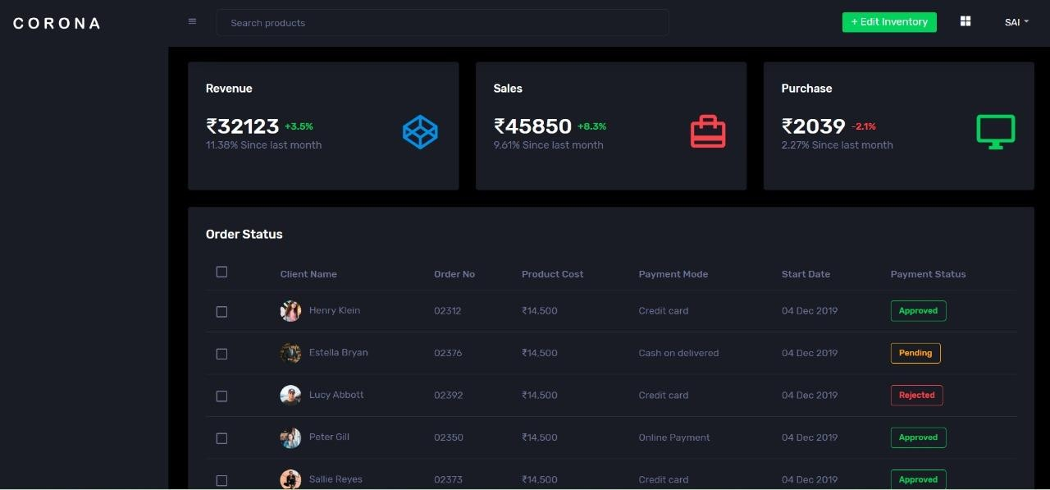

Slide 29
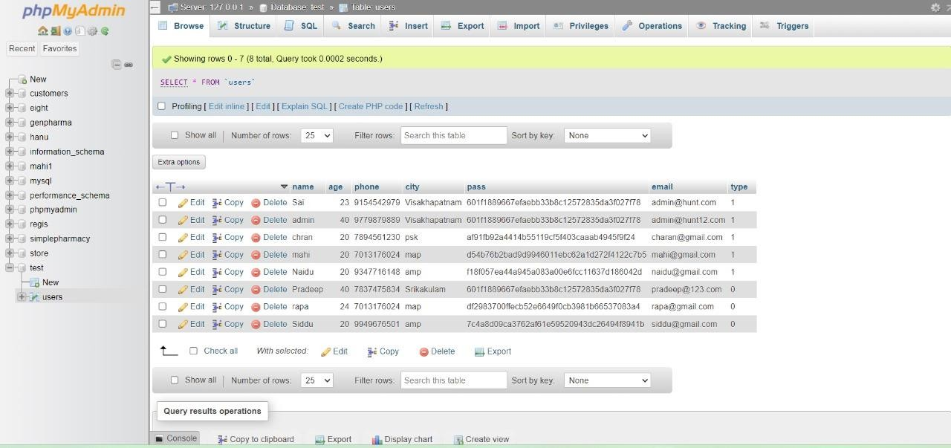
Database:
Admin Table:
Create a table in the database to store admin information, including username, password (hashed and salted), and any additional relevant details.
Database Connection:
Establish a secure connection between the application and the database.
Authentication Process:
Implement a secure authentication process to verify the entered credentials against the stored values in the database.
Password Encryption:
Hash and salt admin passwords before storing them in the database to enhance security.

Slide 30
Conclusion:
In conclusion, the design and implementation of a Pharmacy Management System (PMS) are essential for streamlining and optimizing various processes within a pharmacy. The system plays a pivotal role in enhancing efficiency, ensuring accuracy, and improving overall customer satisfaction. Through the incorporation of user-friendly interfaces, secure authentication mechanisms, and comprehensive database management, a well-designed PMS offers numerous benefits.
The collaboration diagram provides a visual representation of the dynamic interactions between different components, facilitating a clear understanding of the system's functionality. It showcases how various elements collaborate to achieve specific tasks, emphasizing the structural organization of objects and their interconnections

